Slide 1
RANSAC Model: Robust Regression with Outlier Handling Using Python & scikit-learn

Slide 2
Agenda
Introduction to RANSAC
Why do we need RANSAC?
RANSAC Algorithm Intuition
Algorithm Steps & Flowchart
Example: Line Fitting with Outliers
Python Implementation with scikit-learn
Hyperparameters in RANSAC
Limitations & Use Cases
Python Demo Link

Slide 3
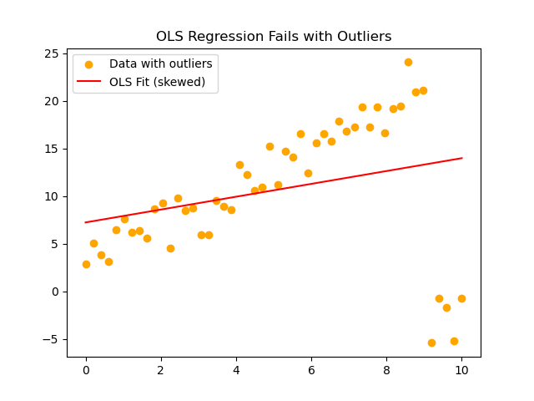
Problem of Outliers

Slide 4
RANSAC Algorithm Steps
1. Randomly sample a subset of points
1
2. Fit model to this subset
2
3. Compute inliers within tolerance
3
4. Repeat many times
4
5. Keep model with most inliers
5

Slide 5
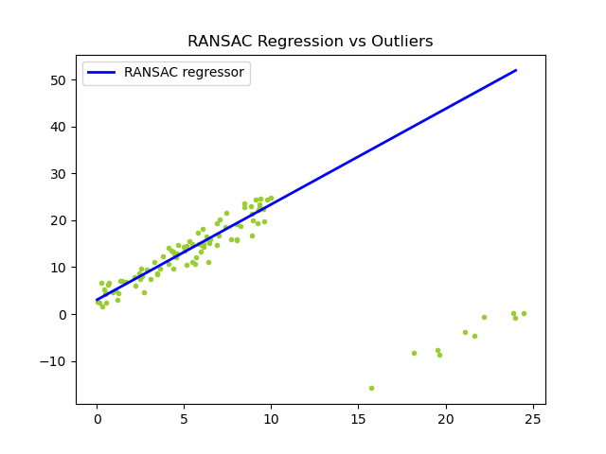
Example: Line Fitting with RANSAC

Slide 6
Demo of Ransac
open ransac_demo.ipynb for practice

